Slide 1
Troubleshoot : Bubble CPAP

Slide 2
1. De-saturating Baby
D isplaced-distorted prongs
O bstructed nares
P neumothorax
E quipment failure
Notes:
When a newborn on CPAP has saturations less than 90% remember the concept of DOPE. Displaced or distorted Prongs, Obstructed nares or nostrils, Pneumothorax or other air leaks and equipment failure

Slide 3
2. Why Won’t It Bubble?
Complete or partial circuit leak
Complete or partial prong disconnect
Displaced prongs
Inadequate flow through the circuit
Prongs are too small for the baby
Baby’s mouth is open
Notes:
If bubbles are intermittent or absent in the bubble chamber this could occur due to complete ro partial circuit leak, copleter or partial nasal prong disconnect, displaced prongs, inadequate flow gases in the circuit, prongs are too small for the baby and or patients mouth is open..

Slide 4
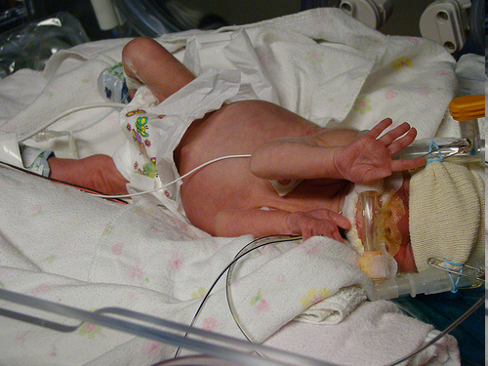
3.Agitated Baby
Minimal handling
Careful interface application
Effective airway clearance
Clustering of care
Feeding
“Hands off ”
? Sedative
Notes:
If a baby on CPAP is agitated watch for nasal injury and secretions. Minimal handling, careful assessment of interface applications, clearing of the nose and throat, clustering of care and feeding would help in comforting the baby. Hands off is a good concept sometimes.. Sedation is never recommended for a struggling baby.

Slide 5
Trouble Shoot
SpO2 | Retractions | Air entry | Bubbling | Diagnosis
Low | ++/+++ | Poor | Yes | Lung disease
Low | +/nil | Good | Yes | PPHN/CHD/blender malfunction
Normal | ++/++++ | Good | Yes | Metabolic acidosis
Low | ++/+++ | Poor | Yes | Obstruction
Low | ++/+++ | Poor | Nil | Leaks

